Slide 1
Critical Thinking Skills
Lecture 1 Introduction

Slide 2
Lecture Outline
Age of information we are living.
What is critical thinking?
What is argument?

Slide 3
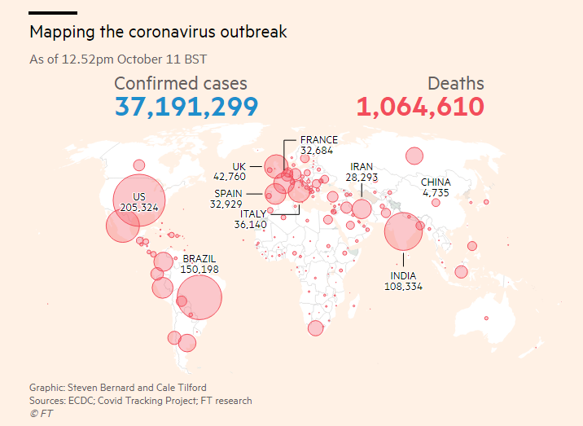
Critical Thinking in Everyday Life

Slide 4
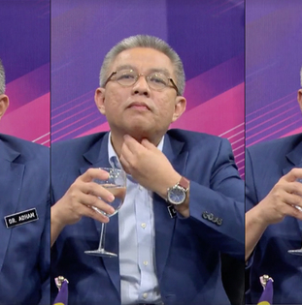
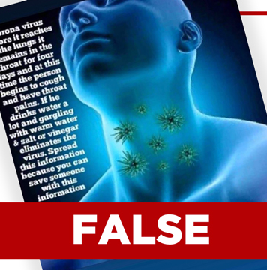
https://www.youtube.com/watch?v=8hLuTaAJjj0

Slide 5
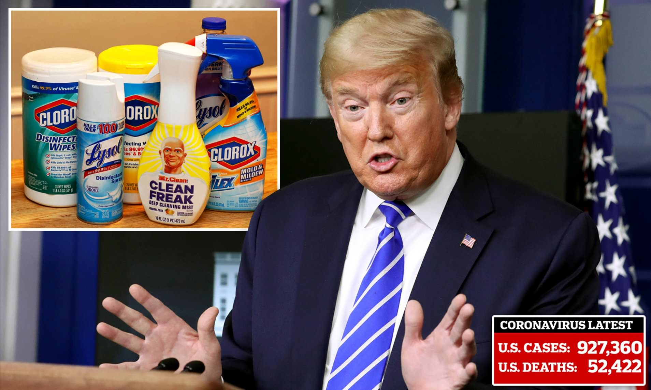
https://www.youtube.com/watch?v=naIOapbb6VE

Slide 6
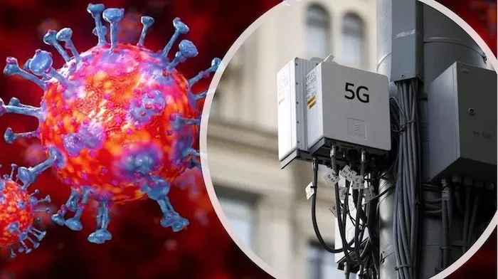
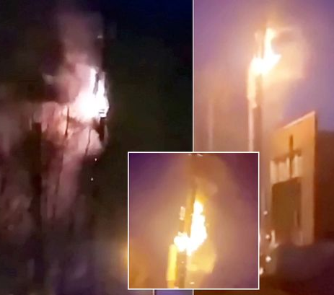
https://www.youtube.com/watch?v=bytUz7T3eHI

Slide 7
All around us…
Fake news
Lies
Rumors
Myths
Conspiracy Theory
Pseudo Science
Predictions
Slogans
Advertisements

Slide 8
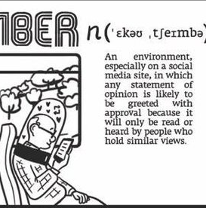
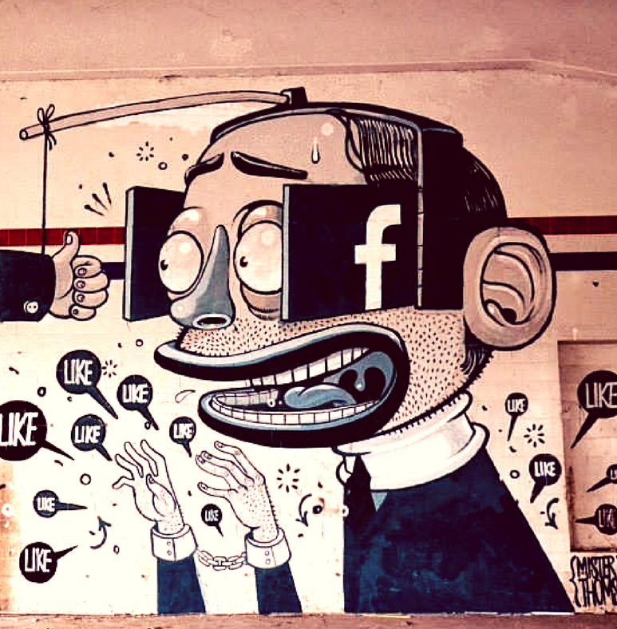
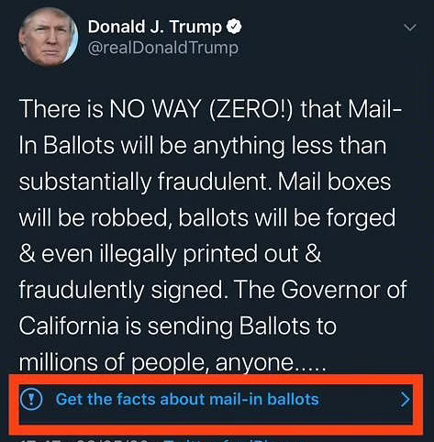
Overflooded by Information
Lack of fact checking
Tunnel vision problem
Echo Chamber Problem

Slide 9
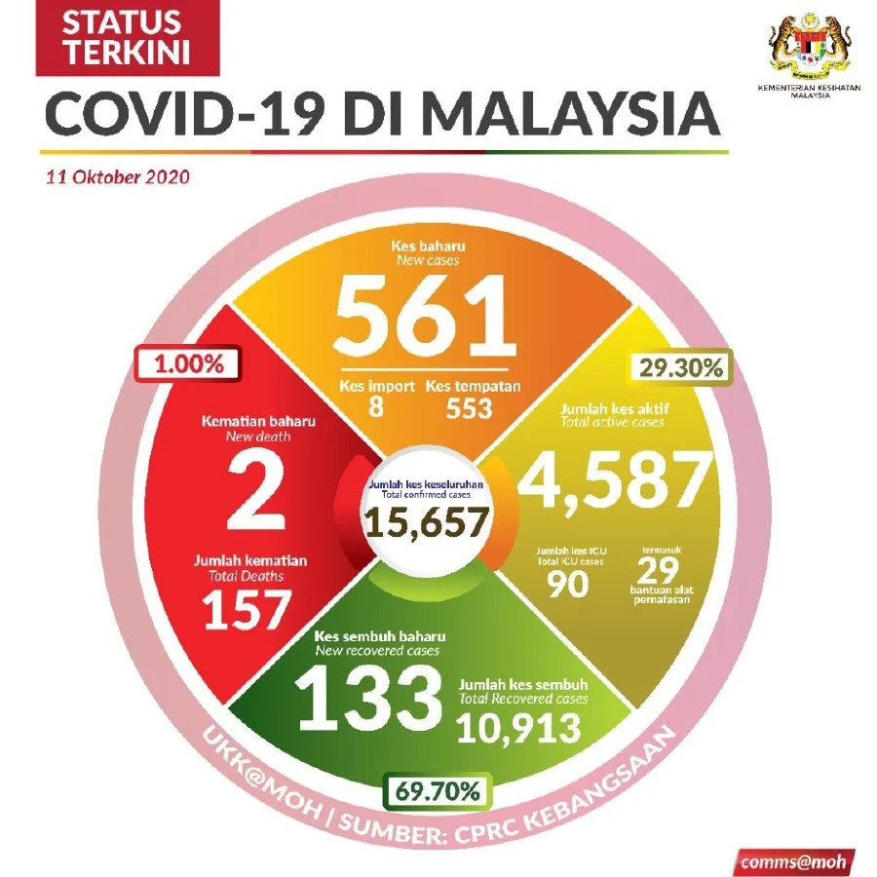

Slide 10
Serious Issues
Should Malaysia be lockdown nationwide?
Should Malaysian Government run MCO 2.0?
Should the Government close the school again?
Should the University stop the face-to-face teaching?

Slide 11
You believe uncritically and blindly, because you think that…
You had an extraordinary personal experience.
You embrace the idea that anything is possible—including weird things.
You have an especially strong feeling that the claim is true or false.
You have made a leap of faith that compels you to accept the claim.
You believe in inner, mystical ways of knowing that support the claim.
You know that no one has ever disproved the claim.
You have empirical evidence that the claim is true.
etc.

Slide 12
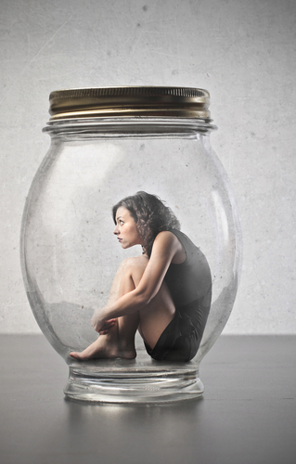
Without thinking critically, you will…
have false beliefs about the world and the people;
make wrong decision and worse action;
even do not know that you are wrong (ignorance).

Slide 13
Citizen Cultural Literacy
In public sphere, there are many problems and issues (tax paying, minimum salary, education policy, etc.) matter for us. Also, our decision would effect on others (family, friends, strangers).
Malaysians are not good at thinking and reasoning.
With critical thinking, we can involve into these discussions rationally, rather than emotionally.
Maybe the discussion is inconclusive, but at least it promotes our knowledge to the problems, to each other (rather than fight with each other).

Slide 14
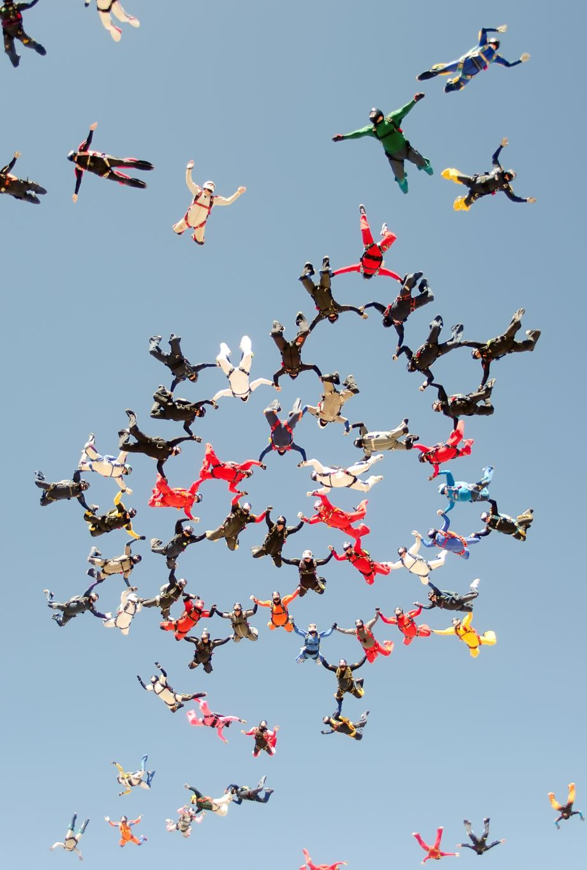
In this course, you will able to know…
Which reasons are good reasons, in distinct from the bad one?
How and when our beliefs are justified?
How and when we can say that we know that something is true or believable?

Slide 15
What is Critical Thinking?

Slide 16
What is Critical Thinking?
Critic:
critique (Fr.), kritikos (Gr.)
To analyse, to separate, to make a judgement
Critical Thinking is…
a reasonable, reflective thinking that is aimed at deciding what to believe or what to do.
an ability to distinguish good reason from bad reason.

Slide 17

Some Misunderstanding
It is not a confrontation and quarrel.
But rather, to rejecting bad ideas, finding the truths.
It does not criticize people all the time.
But rather, a rational discussion with open-minded and principle of charity.
It is not impractical (emotional and self-interested)
But reject authority and force with strategy and wise.
It is not concerned with debate and rhetoric.
It is concerned with how to bring out facts and reason.

Slide 18
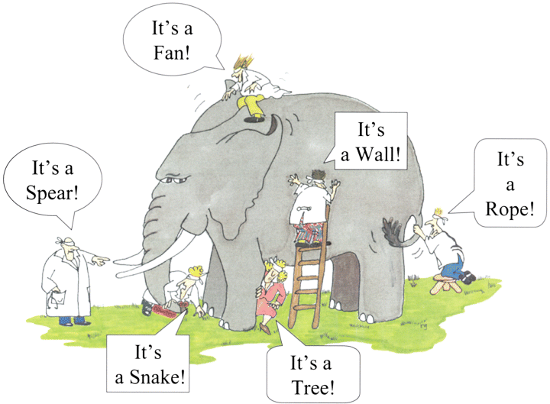
Critical Thinking Is All About…
Having a good reason to believe or to act…

Slide 19
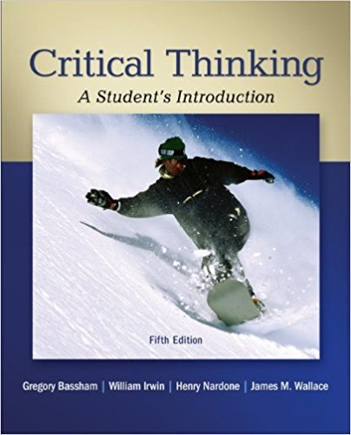
Textbook
Critical Thinking: A Student’s Introduction (5th ed.) / by G. Bassham, W. Irwin, H. Nardone, J. Wallace
Available on Google Classroom

Slide 20

Assessment Scheme
Personal Assignment 40%
Mid-term Examination (Week 7) 30%
Final Examination 30%

Slide 21
Tutorial Classes
Monday | Time
Odd Week | 9:00 – 10:00
 | 12:00-13:00
Even Week | 9:00 – 10:00
 | 12:00-13:00
*Please do the survey form by today *Please rename you Google Classroom ID into “Batch_Name”
Notes:
*TCM 20B Students

Slide 22
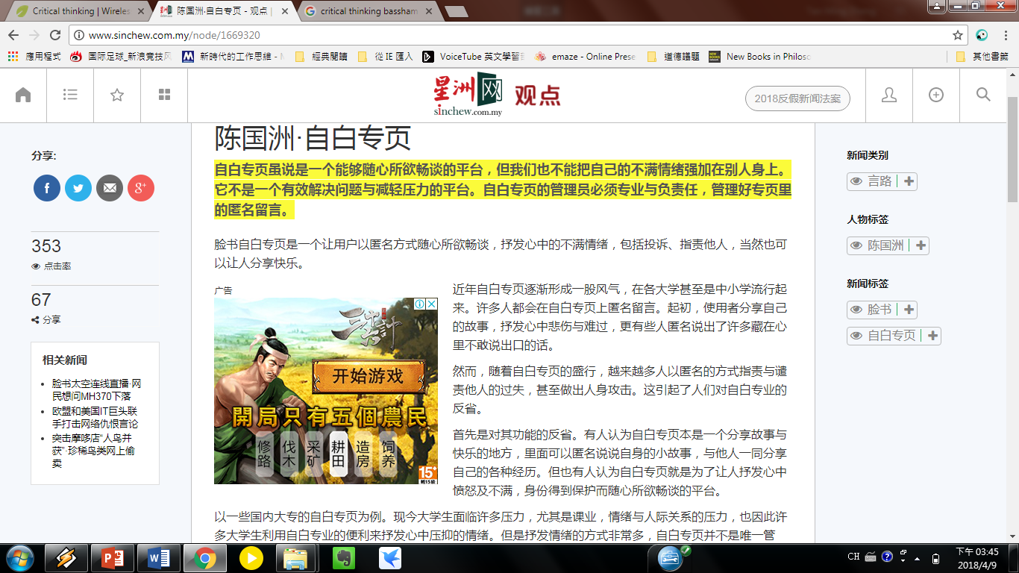
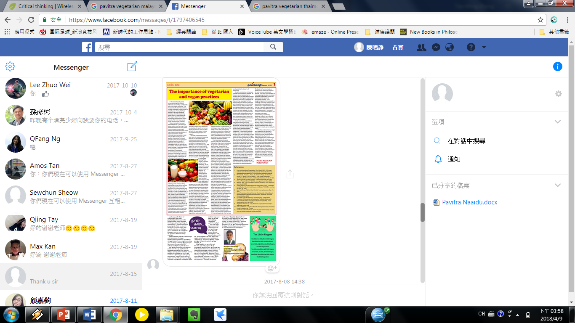
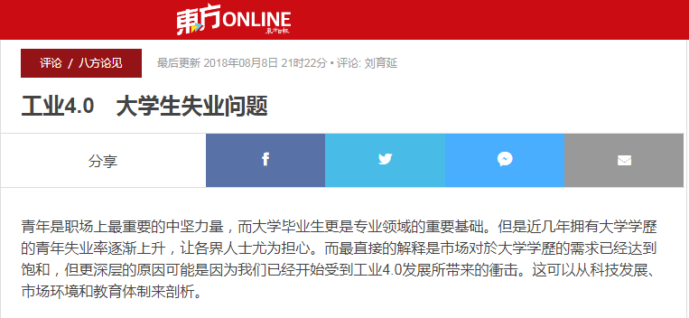
Letters to Editor

